Slide 1

MHW1
Raeli Danilo 1000031326

Slide 2
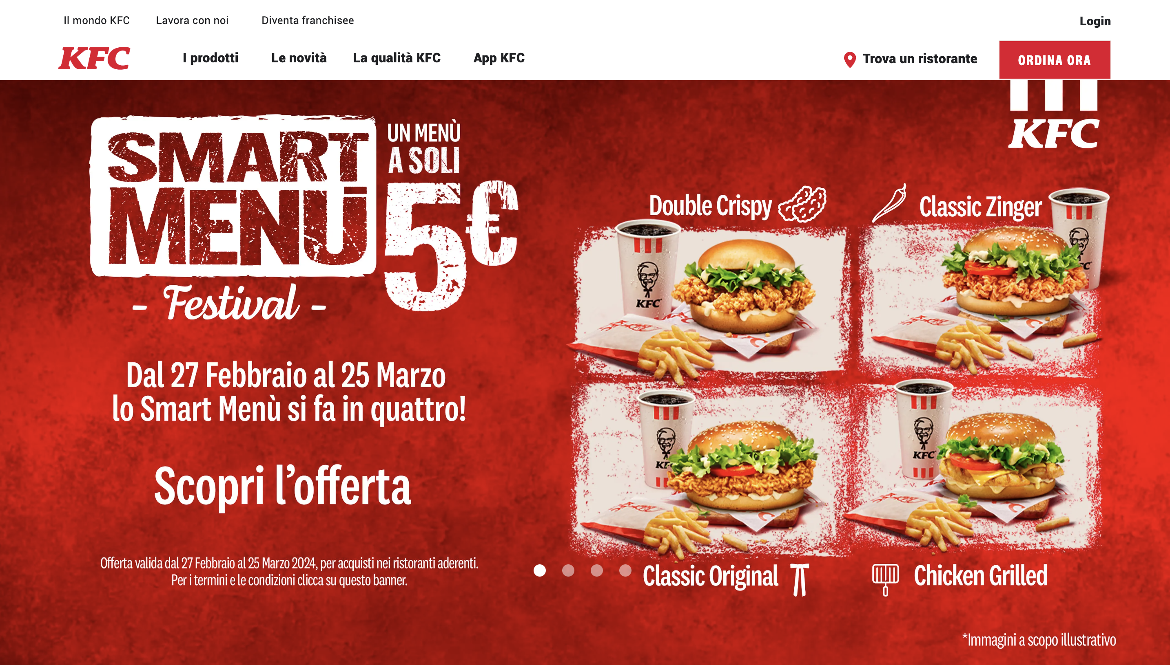
https://www.kfc.it/

